Slide 1
Blackstone River Bikeway/ Greenway for Uxbridge
Blackstone Heritage Corridor (BHC)
Bob Contursi - Director, Initiative Co- chair
Lee Dillard Adams- Director, Initiative Co- Chair
Senator Richard T. Moore, Chairman, BOD
Robert Dandrade – Director
Town of Uxbridge
Board of Selectmen Meeting
February 8, 2021

Slide 2
Agenda
Introductions
Funding Possibilities – Senator Richard Moore
Greenway/ Bikeway Big Picture - Robert Dandrade
What is Needed – Bob Contursi
Close – Q&A + Next Steps

Slide 3
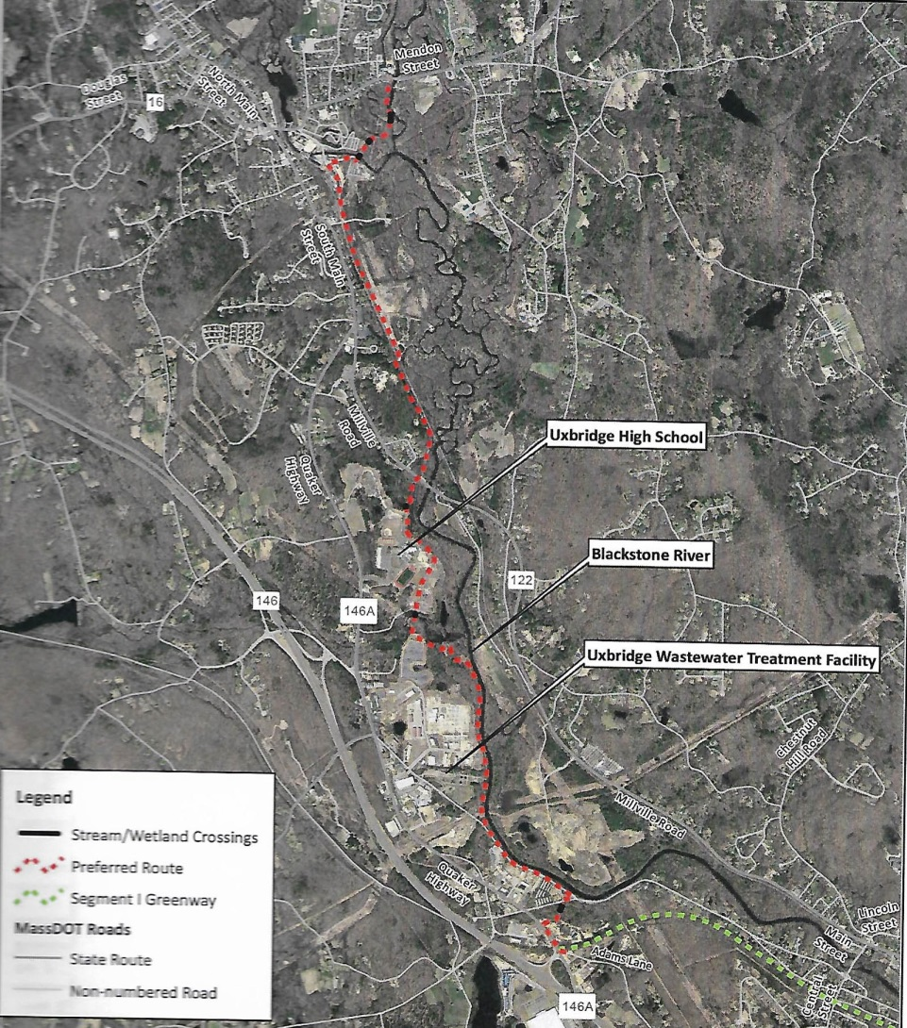
Destination: Uxbridge Center
(phase 1 ends at Depot St)
Goal:
Connect Existing Greenway
In South Uxbridge to
Blackstone River & Canal
(River Bend) State Park
3.3 miles
Easements:
(9) Private
(6) Town Parcels
(2) Utility Co.
(1) Railroad Cross
Existing Greenway
(start here)

Slide 4
Partnership of BHC & Town of Uxbridge
What is Needed?
Public Land – Spring 2021 town meeting warrant
Private lands – Sewer infrastructure access
Partnership of BHC & Town of Uxbridge
Notes:
“Greenway experiences are intensely personal: providing far more than a chance for people to experience nature, interact with neighbors and learn about their native environments”, State of Massachusetts report

Slide 5
Close
Q&A
Next Steps

